Slide 1
2022 Annual Action Plan for Housing and Community Development CDBG, HOME, HTF, ESG, HOPWA, CHDO
Virtual Thursday, March 3, 2022 @ 10:00 AM
https://www.mshomecorp.com/
In-Person Thursday, March 10, 2022 @ 10:30 AM
North Delta Planning & Development
District
220 Power Drive, Batesville, MS 38606
In-Person Tuesday, March 29, 2022 @ 1:00 PM
Beau Rivage
875 Beach Boulevard, Biloxi, MS 39530

Slide 2
Welcome/Overview
Steve Hardin, CSD Division Director Mississippi Development Authority
Affirmatively Furthering Fair Housing Statement
Erica Fell, Housing Grant Officer
Mississippi Home Corporation
Community Development Block Grant Program (CDBG)
Ray Robinson, Jr., Bureau Manager, Compliance
Mississippi Development Authority
Lisa Maxwell, Bureau Manager, CDBG
Mississippi Development Authority
MHC Federal Programs Allocation of Funds 2022
Kimberly Stamps, AVP, HOME/HTF
Mississippi Home Corporation
Tamara Stewart, Grants Manager
Mississippi Home Corporation
Change to State’s Citizen Participation Plan
David Hancock, VP, Executive Division Mississippi Home Corporation
ADJOURN
Public Comments will be accepted from April 1, 2022 – May 1, 2022. Please submit comments to David Hancock at the following address: 735 Riverside Drive, Jackson, MS 39202 or david.hancock@mshc.com
Please visit MHC's website at www.mshomecorp.com and provide your email address to receive announcements and news updates.
Y

Slide 3
Purpose of Public Review
Meetings:
Gather public input on the Allocation of expected Federal Program Funding for 2022.
Gather public input on the production of housing units and services from 2021.
Explain how to provide written comments on actions proposed to be taken by MHC and MDA

Slide 4
Affirmatively Furthering Fair Housing
MHC and MDA works to affirmatively further fair housing by taking meaningful actions, in addition to combating discrimination, that overcome patterns of segregation and foster inclusive communities free from barriers that restrict access to opportunity based on protected characteristics.

Slide 5
Economic Development Strategies:
Create, expand, and retain more jobs for lower-income persons
Create or Expand Employment at For-Profit Businesses
Invest in Eligible Infrastructure That Supports Better Paying Jobs

Slide 6
Infrastructure Strategies:
Improve the quality of Mississippi’s infrastructure and public facilities
Improvement of Local Community Living Environment
Construction, rehabilitation or improvement of community service facilities
Eliminating conditions detrimental to health, safety and public welfare

Slide 7
2019 Consolidated Annual Performance and Evaluation Report (CAPER)
Reporting Period: July 1, 2020 - June 30, 2021
CDBG Funds Expended $9,937,919
CDBG Economic Development Program created 1,566 jobs.
CDBG funds were also used by local governments to provide public facilities and infrastructure improvements in low- and moderate-income areas. 86,966 persons were assisted for this purpose during program year 2020.

Slide 8
ACCOMPLISHMENTS FOR 2021 CDBG
Program Categories | Category | Projects Funded | Project Amounts
Public Facilities
 | Regular | 16 | $ 8,152,931.20
 | Small Government | 33 | $13,674,179.75
Economic Development | Public Improvements | 2 | $2,407,022.00
State Administration |  |  | $800,000

Slide 9
2022 CDBG Proposed Budget Estimate
Proposed Categories |  |  | Allocation
Public Facilities |  |  | $13,203,611
 | Regular | $ 4,000,000
 | Small Government | $ 9,203,611
 | Additional Funding |  | TBD
Economic Development | Public Improvements |  | $12,000,000
State Administration |  |  | $ 800,000
Total Allocation |  |  | $26,003,611

Slide 10
CDBG 2022 Overview
Eligible Applicants: Incorporated municipalities and counties (excluding entitlements: Biloxi, Gulfport, Hattiesburg, Jackson, Moss Point, and Pascagoula)
National Objective: Benefit 51% Low- and Moderate-Income Individuals or Families
Economic Development Projects
Minimum Job Creation: 20 net new jobs created
Grant Amount: Maximum of $25,000 per job up to $2,500,000
Public Facilities Projects
Small Government Category- local governments less than 3,500 pop.
Maximum Grant Size $600,000
Regular Government Category- all local units of government
Maximum Grant Size $750,000

Slide 11
CDBG 2022 Compliance Overview
All Sub-recipients will be monitored at least once over the life of a funded project.
A Risk Assessment may be performed on all Sub-recipients to determine program progress and compliance.
MDA will continue to Affirmatively Further Fair Housing by supporting local fair housing efforts, non-profit partnerships, thru MDA sponsored trainings and outreach efforts and partnership efforts with MHC.
MDA will ensure Sub-recipients Affirmatively Further Fair Housing within their respective communities as required by the federal funds received and conduct a fair housing activity during the grant implementation stage.

Slide 12
CDBG APPLICATION DATES
Public Facilities:
Applications for Regular and Small Government are due:
May 16-20, 2022
Economic Development:
Applications for Economic Development will be accepted throughout the year.

Slide 13
Draft Plan Availability
Public Comment Period
Public Comments
April 1, 2022
www.mississippi.org
Community Forms Library
www.mshomecorp.com
April 1, 2022
to
May 1, 2022
David Hancock
Mississippi Home Corporation
735 Riverside Dr.
Jackson, MS 39202

Slide 14
CDBG CONTACTS
Steve Hardin – Director, Community Incentives Division
Phone: 601.359.2366
Lisa Maxwell – Manager, Community Development Bureau
Phone: 601.359.2498
Ray Robinson, Jr. – Manager, Compliance Bureau
Phone: 601.359.9273

Slide 15
MISSISSIPPI HOME CORPORATION MISSISSIPPI DEVELOPMENT
AUTHORITY
2022 Annual Action Plan

Slide 16
PUBLIC HEARING MEETING
OVERVIEW

Slide 17
MHC Federal Programs Process:
The 2022 Annual Action Plan will be submitted to HUD by May 15, 2022. Three (3) public input meetings are scheduled. The first is to be held virtually on March 3, 2022, at 10:00 am via the MHC website; the second is to be held in-person on March 10, 2022, at 10:30 am in Batesville, Mississippi at the office of North Delta Planning and Development District and the third is to be held in-person on March 29, 2022, at 1:00 pm in Biloxi, Mississippi at MHC’s 30th Annual Conference at the Beau Rivage.
A public comment period will be held April 1, 2022 – May 1, 2022. Comments received will be considered for incorporation in the Annual Action Plan by Mississippi Home Corporation (MHC) for HOME, ESG, HOPWA, and HTF programs and Mississippi Development Authority (MDA) for the Community Development Block Grant program (CDBG).

Slide 18
Activities
The following programs will be identified in the 2022
Annual Action Plan.
HOME Investment Partnerships Program (HOME)
Homeowner Rehabilitation
Homeowner Rehabilitation Disaster
Rental
Home Buyer Assistance
Community Housing Development Organization (CHDO)
National Housing Trust Fund (HTF)
Housing Opportunity for Persons with AIDS (HOPWA)
Emergency Solutions Grant Program (ESG)

Slide 19
HOME Investment Partnerships Program (HOME)
The HOME Investment Partnerships Program (HOME) provides funding to states and localities that communities use - often in partnership with local nonprofit groups - to fund a wide range of activities including building, buying, and/or rehabilitating affordable housing for rent or homeownership or providing direct rental assistance to low-income people. It is the largest Federal block grant to state and local governments designed exclusively to create affordable housing for low-income households.

Slide 20
HOME Investment Partnerships Program (HOME), cont’d
The program was designed to reinforce several important values and principles of community development:
HOME's flexibility empowers people and communities to design and implement strategies tailored to their own needs and priorities.
HOME's emphasis on consolidated planning expands and strengthens partnerships among all levels of government and the private sector in the development of affordable housing.
HOME's technical assistance activities and set-aside for qualified community-based nonprofit housing groups builds the capacity of these partners.

Slide 21
(HOME) - Homeowner Rehabilitation
Funds are used to provide safe, decent, affordable housing by eliminating substandard conditions, through rehabilitation or reconstruction of owner-occupied units. HOME funds are distributed through a competitive process.

Slide 22
Homeowner Rehabilitation Program Year: 2021
Homeowner Rehabilitation Program
Total Number of households assisted: 32 units
Estimated beneficiaries: 60
Total Amount Funded: $2,446,965
Total Expenditures: $1,537,420.90

Slide 23
(HOME) - Homeowner Rehabilitation Disaster
Funds are used to provide housing assistance to counties covered by an Emergency or Major Disaster Declaration issued by the Federal Emergency Management Agency (FEMA). Counties impacted by the disaster are eligible to apply. Eligible activities under this Program are repair, rehabilitation of single-family owner-occupied housing and rehabilitation, replacement of owner-occupied manufactured housing.

Slide 24
(HOME) - Rental
Funds will be used to provide rental housing for low to very low-income households. The Rental Housing Set-Aside funding will provide "gap" financing for rental housing development activities, acquisition/rehab for rental housing activities, or substantial rehabilitation of rental units.
For-profit and non-profit organizations with demonstrated experience and capacity to undertake HOME activities, according to HUD regulations may apply. HOME funds are distributed through a competitive process and in the form of a cash flow loan.

Slide 25
(HOME) – Home Buyer Assistance
Home Buyer Assistance Set-Aside funds will be used to provide down- payment, principal reduction, and closing cost assistance to income eligible households to purchase a home. Thirty-three percent (33%) of funds will be dedicated to serving persons with disabilities. MHC expects to contract with one or more HUD-approved housing counseling agencies to identify eligible households, collect documentation required to determine eligibility for HOME funds, and work with buyer and lender through loan closing. MHC will make the final determination about the applicant’s eligibility and the amount of financial assistance to be allowed.

Slide 26
Community Housing Development Organization (CHDO)
This funding provides eligible non-profit organizations that act in the capacity of Owner and/or Developer to undertake HOME activities in the development of low-income housing or substantial rehabilitation of multi-family rental units. Applicants applying for this set-aside must first be certified as a CHDO through the State.

Slide 27
National Housing Trust Fund
(NHTF)
The primary purposes of the Housing Trust Fund is to increase and preserve the supply of rental housing for extremely low- income households earning less than 30% of area median income (AMI). The State is required to prepare a separate Annual Allocation Plan for HTF. It is submitted with the Annual Action Plan along with other HUD Programs.

Slide 28
Program Year: July 1, 2020 - June 30, 2021
HTF Rental Reservations
(4) Developments-$3,420,091
HOME Rental Reservations
(4) Developments-$6,002,460
HOME CHDO Rental
(1) Development-$675,666

Slide 29
Housing Opportunity for Persons with AIDS (HOPWA)
HOPWA funds provide services for low-income persons/families with HIV/AIDS to prevent homelessness. The proposed activities for 2022
are: Short-Term Rent, Mortgage and Utility assistance (STRMU), Tenant-Based Rental Assistance (TBRA), Short- Term Supported housing, Master Leasing, Permanent Housing Placement, housing information, supportive services, resource identification, acquisition, construction, or rehabilitation of structures used for eligible HOPWA activities, and technical assistance.

Slide 30
HOPWA changes to coverage area
HUD revised the composition of the Memphis, TN-MS-AR Metropolitan Statistical Area (MSA) and Jackson, MS MSA.
Due to these revisions, Benton County, MS is no longer within the Memphis HOPWA Eligible Metropolitan Statistical Area (EMSA). Benton County is now within the balance of state jurisdiction of the State of Mississippi HOPWA program.
In addition, Holmes County, MS is now within the Jackson HOPWA Eligible Metropolitan Statistical Area (EMSA). Holmes County was previously within the balance of state jurisdiction of the State of Mississippi HOPWA program. These changes apply to FFY 2022 and subsequent allocations.

Slide 31
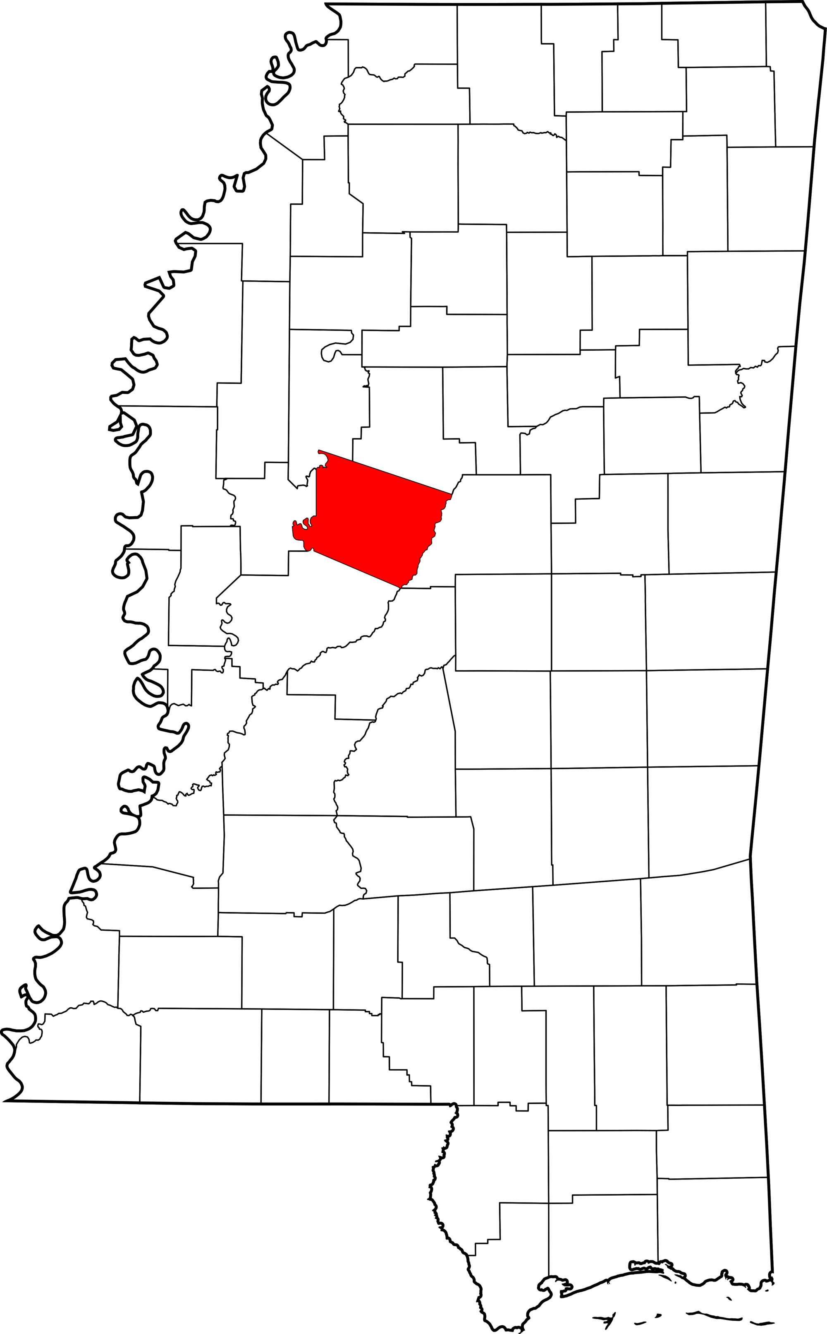
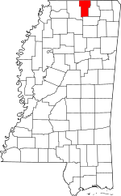
Map
Benton County, MS
Holmes County, MS

Slide 32
Emergency Solutions Grant Program (ESG)
ESG Program is designed to improve administrative efficiency and enhance response coordination and effectiveness in addressing the needs of homeless persons. Proposed program activities for 2022:
services for persons who are homeless, at risk of homelessness
services for special populations such as homeless youth, victim services (victims of human trafficking)
The five ESG program components are: street outreach, emergency shelter (homeless population, domestic violence and children and youth), rapid re-housing of homeless individuals and/or families, homeless prevention to individuals and/or families at risk of homelessness, and Homeless Management Information System (HMIS) data collection.
ESG services (street outreach, shelter, RRH, HP, HMIS) will be accessible throughout the entire state of MS.
ESG policies will be updated to include allowing all ESG activities in the Central CoC coverage area.

Slide 33
2021 (ESG)
Estimated Units and Individuals Assisted
ESG | 13 Projects awarded | Total= $2,355,068 | Avg/month
Shelter | 297
Shelter |  |  | 50
Rapid Rehousing | 200 |  | 33
Homeless Prevention | 151 |  | 25
HOPWA | 5 Projects (2 construction) | $1,876,829 | Avg/month
Total unique clients | 390 |  | 65
STRMU | 59 |  | 10
TBRA | 208 |  | 35
PHP | 93 |  | 15
Master Leasing | 30 |  | 5

Slide 34
MHC Federal Programs Proposed Allocation 2022
The proposed allocation of funds for 2022 are estimated based on the amount received in 2021 funding. Allocations to activities will be adjusted proportionately based on actual Federal Funds
Received in 2022

Slide 35
Program | Activities | Proposed Allocation of Funds estimate based on amount received in 2021
ESG | Rapid Re-Housing | $447,469
 | Shelter | $974,000
 | Homeless Prevention | $241,944
 | Street Outreach | $439,100
 | HMIS* | $132,555
 | State Administration | $120,000
TOTAL ESG |  | $ 2,355,068
HOME | Homeowner Rehabilitation | $2,324,382
 | Rental | $3,830,540
 | Home Buyer Assistance | $1,000,000
 | CHDO Set-Aside | $1,540,984
 | CHDO Operating Expenses | $50,000
 | Disaster | $500,000
 | State Administration | $1,027,323
TOTAL HOME |  | $10,273,229

Slide 36
Program | Activities | Proposed Allocation of Funds estimate based on amount received in 2021
HOPWA | Substantial Rehab/New Construction | $500,000
 | Services | $1,376,829
TOTAL HOPWA |  | $1,876,829
HTF | Construction/Rehabilitation | $3,610,816
 | Admin | $401,202
TOTAL HTF |  | $4,012,018

Slide 37
Funding Availability
Available Grants | Application Open | Application Closed
ESG | April 22, 2022 | May 20, 2022
HOPWA | April 22, 2022 | May 20, 2022

Slide 38
Change to State’s Citizen Participation Plan
Federal Regulations:
24CFR91:501
Amendments to the plan. The jurisdiction shall amend its approved plan whenever it makes one of the following decisions:
(1) To make a change in its allocation priorities or a change in the method of distribution of funds;
(2) To carry out an activity, using funds from any program covered by the consolidated plan (including program income, reimbursements, repayment, recaptures, or reallocations from HUD), not previously described in the action plan; or
(3) To change the purpose, scope, location, or beneficiaries of an activity.
Currently, the State’s Citizen Participation requires: the allocation or reallocation of more than 10%, unless provided for, otherwise in the plan;
The State proposes to increase the allocation or reallocation amount from “more than 10%”, to “more than 50%”…to allow the use of HUD funds to meet demands more efficiently and effectively than currently allowed.

Slide 39
PUBLIC COMMENTS
Public Comment Period
Public Comments should be submitted to:
Draft Plan Availability
• April 1, 2022
www.mshomecorp.com
•April 1 – May 1, 2022
Mississippi Home Corporation
Attn: David Hancock
735 Riverside Drive
Jackson, MS 39202
•david.hancock@mshc.com

Slide 40
CONTACT INFORMATION
David Hancock – AAP Public Comments (601) 718-4620
Tamara Stewart - ESG/HOPWA - (601) 718-4654
Kimberly Stamps - HOME/HTF- (601) 718-4638
Lisa Coleman – SVP of Federal Grants - (601)718-4757

Slide 41
CONTACT INFORMATION
Mississippi Home Corporation 735 Riverside Drive
Jackson, MS 39202 601-718-4642
www.mshomecorp.com

